Slide 1

Industry Project Project
Presentation
on
“Travel Rate Scraping”
By
Hem Kamli (20162101005)
Institute of Computer Technology, Ganpat University
Date: 12/05/2024

Slide 2
Table of Contents
Introduction
Objectives
Expected Outcome
Tools & Technology
Methodology
Implementation Details
Screenshots
Conclusion

Slide 3
Introduction
The flight data scraping project aims to revolutionize the process of gathering flight information from diverse online platforms, streamlining it into a centralized database for user accessibility. By automating data collection and aggregation, the project simplifies the search for the best flight deals, presenting comprehensive information through an intuitive dashboard.

Slide 4
Objective
Develop a travel rate scraping system to collect flight data from diverse sources and store it into a database.
Implement web scraping algorithms for extracting flight information from B2B and B2C websites.
Design a database schema for efficient storage and management of scraped data. Develop a user-friendly dashboard interface displaying cheapest flights and all available options for a given route.
Implement algorithms for analyzing and comparing flight prices, enabling informed decisions.
Ensure scalability and reliability of the system for future expansions and updates.

Slide 5
Expected Outcome
Users can anticipate a comprehensive travel rate scraping system that simplifies the process of accessing flight data from various sources. With a user-friendly dashboard interface, the system aims to streamline decision-making by presenting all relevant flight options efficiently. Cost savings, time efficiency, and enhanced user experience are expected outcomes, alongside scalability and reliability to accommodate future expansions.

Slide 6
Tools & Technology
Crawlee (Playwright): Node.js library for web scraping, providing robust automation capabilities for extracting flight data from B2B and B2C travel websites.
MySQL: Relational database management system chosen for storing and managing scraped flight data efficiently.
Next.js: React framework utilized for frontend dashboard development, offering server-side rendering and client-side routing capabilities for creating interactive and responsive web applications.
Express.js: Backend framework employed for developing API endpoints to interact with the MySQL database, facilitating CRUD operations for retrieving, updating, and deleting flight data.
JSON: File storage format utilized for storing request body data, which is then utilized in Crawlee for customization and configuration of scraping tasks.

Slide 7
Methodology
The methodology for the travel rate scraping project entails several key steps. Firstly, web scraping is conducted using Crawlee (Playwright), a Node.js library, to automate the extraction of flight data from diverse B2B and B2C travel websites. Custom scraping scripts are developed to accurately extract relevant flight information, with error handling mechanisms implemented to ensure reliability. Next, a MySQL database is established to efficiently store and manage the scraped data, employing a well-designed schema to organize flight details effectively. Development of the user-friendly dashboard interface is carried out using Next.js, enabling seamless display and exploration of flight information. Integration and testing phases ensure the system's functionality, accuracy, and performance are validated, with any identified issues addressed to meet project objectives and user requirements. Through this methodology, the project aims to deliver a robust and valuable solution for simplifying the flight booking process.

Slide 8
Implementation Details
Develop custom web scraping scripts using Crawlee (Playwright) and Node.js to extract flight details from B2B and B2C travel websites, incorporating robust error handling for data reliability.
Utilize a MySQL database with a defined schema to efficiently store and manage scraped flight data, enabling seamless interaction via API endpoints created with Express.js for retrieval and updates.
Implement a user-friendly dashboard interface using Next.js to display and explore flight information, providing a frontend platform for users to interact with the stored data effortlessly.

Slide 9
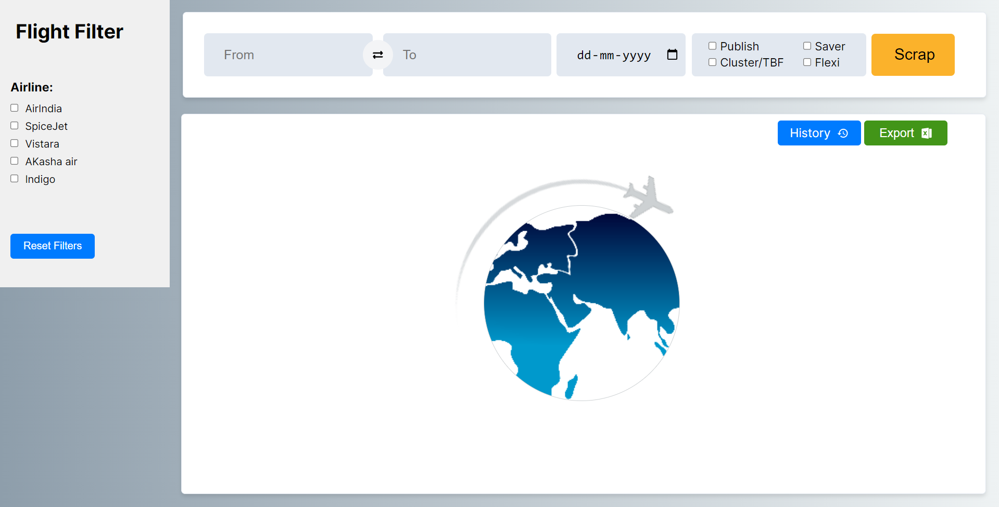
Screenshots

Slide 10
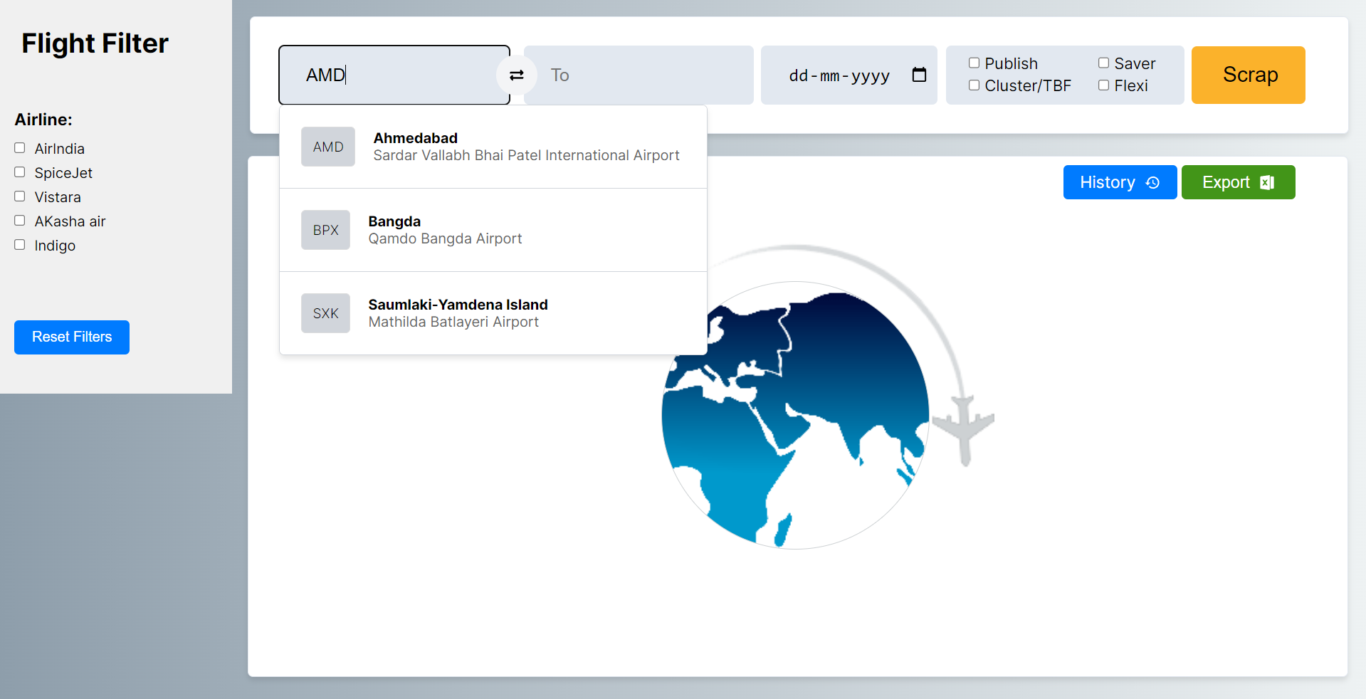

Slide 12
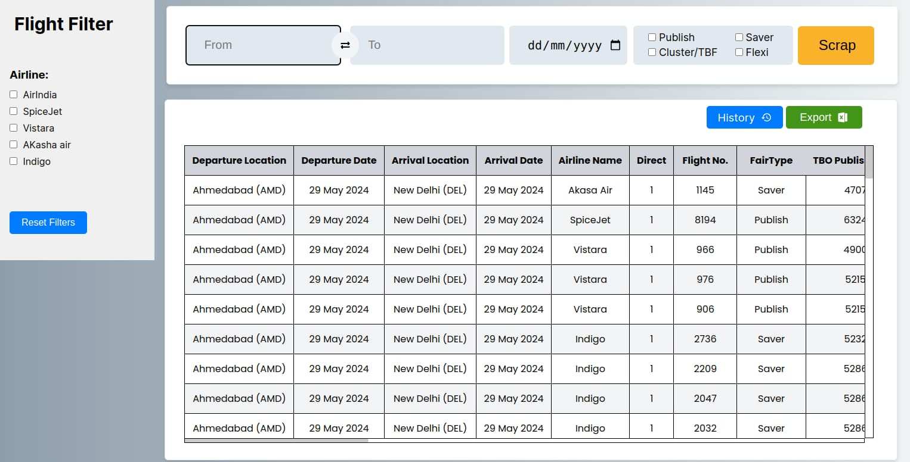

Slide 13
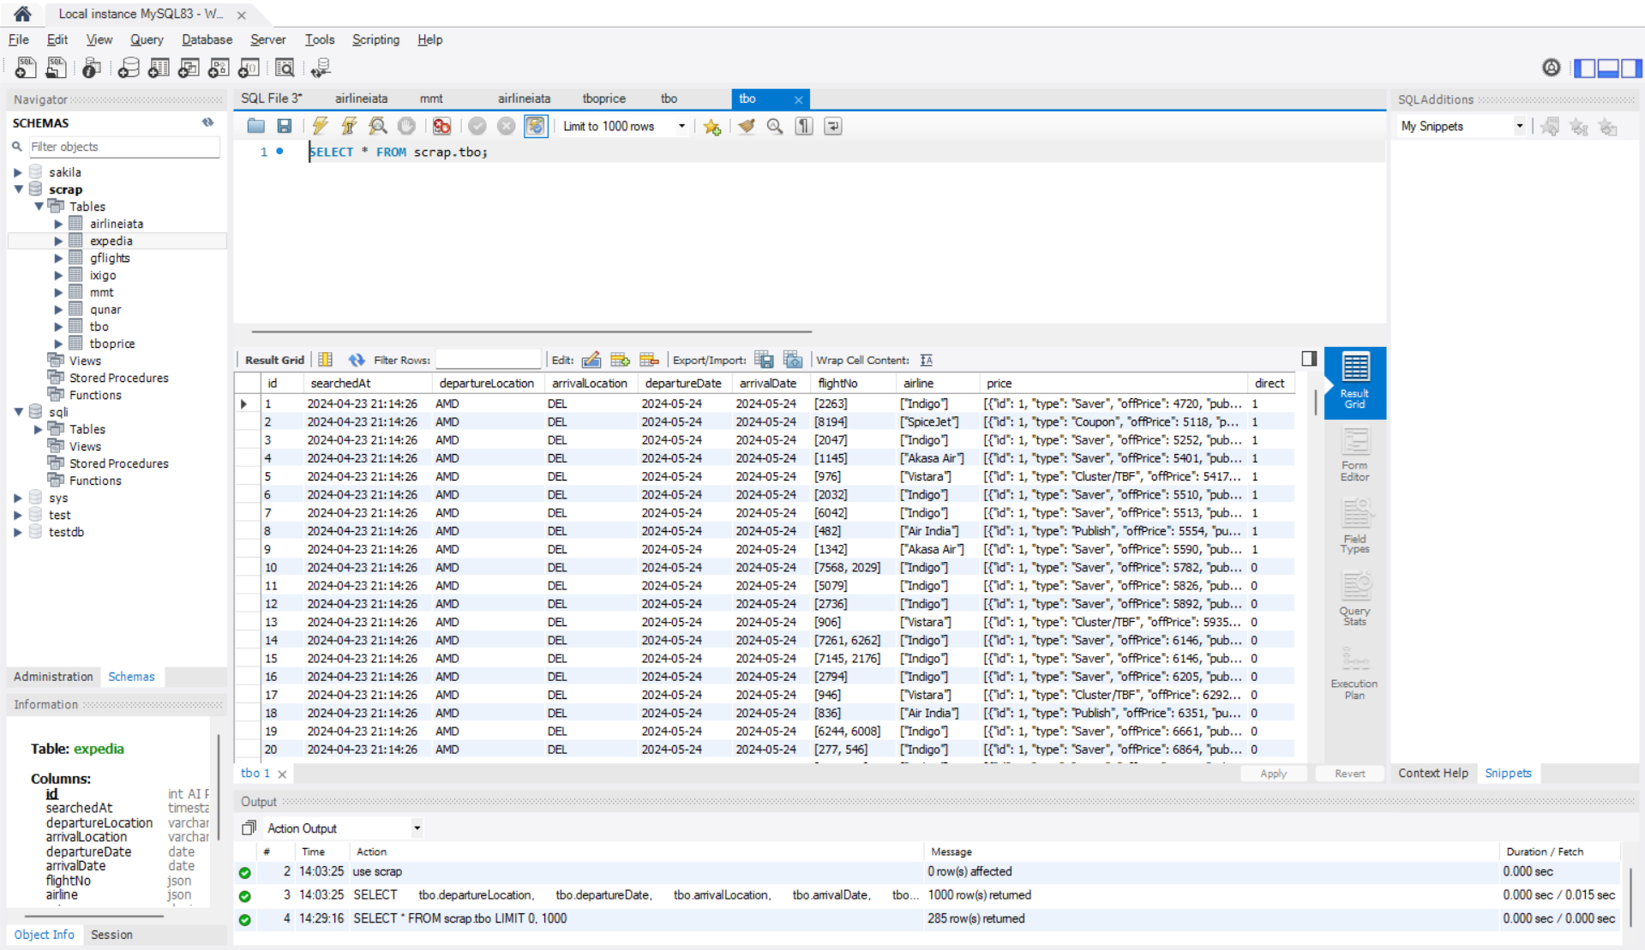

Slide 14
Conclusion
The travel rate scraping project promises to streamline the process of accessing flight data, offering users a comprehensive and user-friendly platform for informed decision-making. Through web scraping, database management, and frontend development, the project aims to simplify the flight booking experience. With a focus on efficiency and usability, this solution is poised to enhance the travel planning process for users, ensuring they find the best flight deals with ease.

Slide 15
Thank You!

